Slide 1
Developing a New Tool: State Machine Deployment to Java
Xactium Ltd

Slide 2
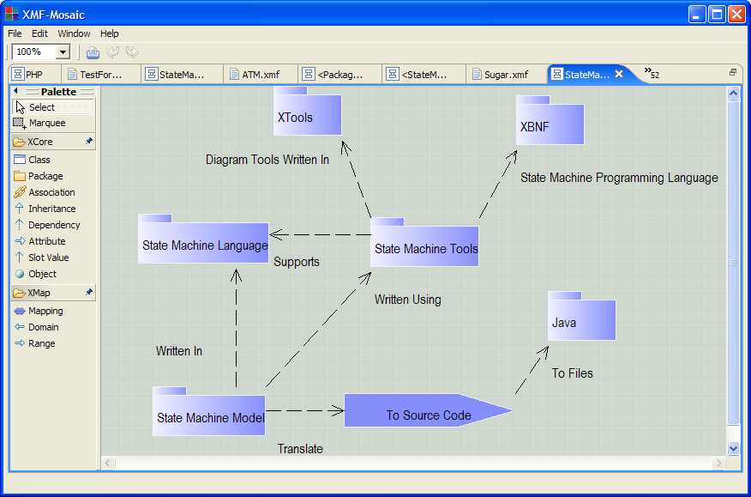
Overview

Slide 3
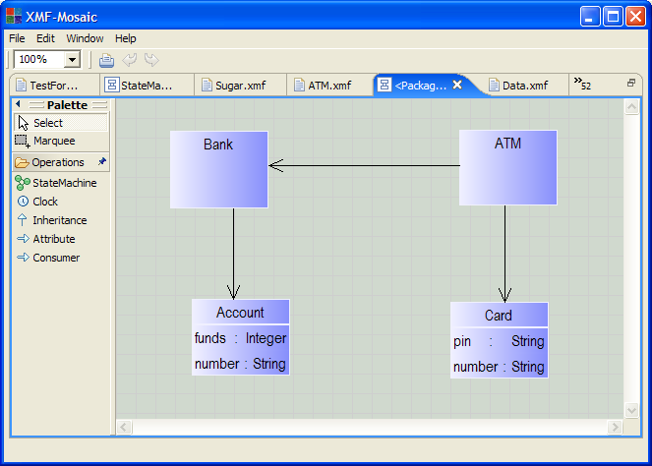
A Tool For State Machines

Slide 4
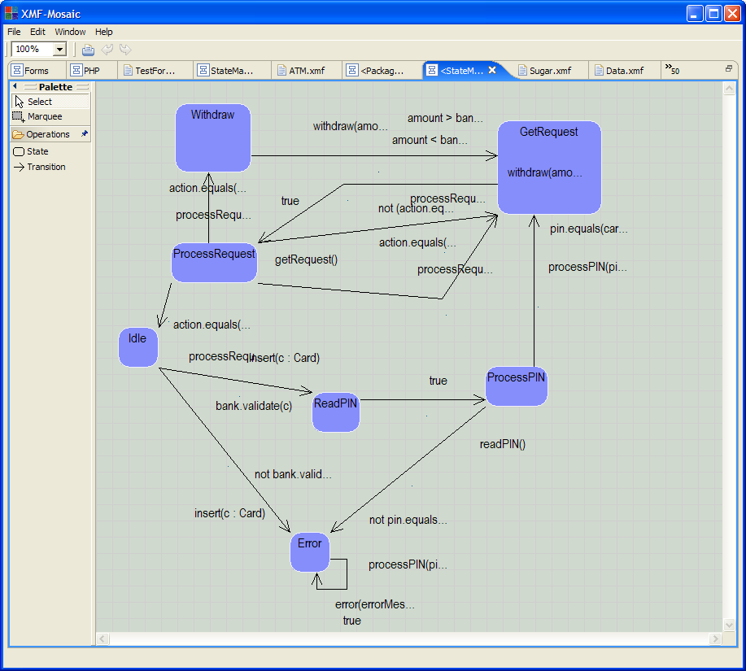

Slide 5
A State Machine Programming Language
@StateMachine ATM
@InitialState Idle end
@State Error end
@State ReadPIN end
@State ProcessPIN end
@State GetRequest end
@State ProcessRequest end
@State Withdraw end
@Attribute bank : Bank end
@Attribute card : Card end
@Transition insert(c:Card) Idle -> ReadPIN
when bank.validate(c)
do self.card := c;
self.readPIN()
end

Slide 6
Generated Java
package Banking;
public class ATM implements messages.StateMachine {
// Attributes...
private String state;
private Bank bank;
private Card card;
// Accessors...
public String state(){ return state; }
public Bank bank(){ return bank; }
public Card card(){ return card; }
// Updaters...

Slide 7
Generates Message Handler
// Handler for messages...
public void send(messages.Message message) { if(message.name().equals("processRequest") &&
_s_ == ProcessRequest) {
String action = message.arg(0).stringValue();
if(action.equals("3")) {
_s_ = Idle;
this.card = null;
if(Main.save(this)) {
this.send(new Message("trace",
new Arg[]{new Arg("Goodbye")}));
} else {
this.send(new Message("trace",
new Arg[]{new Arg("Problem in saving.")}));
}
}
}

Slide 8
Technology
A State Machine Profile
An XBNF Grammar for the State Machine Language
XTools for machine classes and state machines.
Mappings to Java source code.

Slide 9
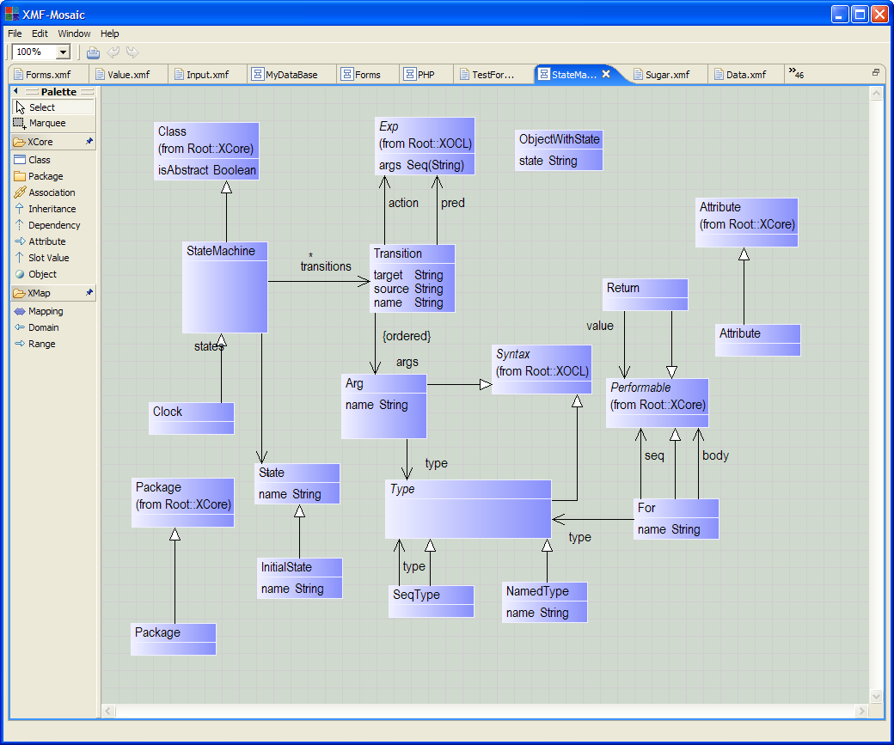

Slide 10
XBNF Grammar
@Grammar extends OCL::OCL.grammar
Transition ::= n = OptName args = MessageArgs s = Name '->' t = Name
'when' c = Exp 'do' a = Exp {
[| StateMachines::Transition(
<StrExp(n)>,
<SetExp("Seq",args)>,
<StrExp(s)>,
<StrExp(t)>,
<XOCL::Exp(c,args.name,null)>,
<XOCL::Exp(a,args.name,null)>) |]
}.
OptName ::= Name | { "" }.
MessageArgs ::= NoMessageArgs | SomeMessageArgs.
NoMessageArgs ::= '(' ')' { Seq{} }.
SomeMessageArgs ::= '(' a = MessageArg as = (',' MessageArg)* ')' {
Seq{a | as } }.
MessageArg ::= n = Name ':' t = MessageArgType { Arg(n,t) }.
MessageArgType ::= n = Name { NamedType(n) } | 'Seq' '(' t =
MessageArgType ')' { SeqType(t) }.
end

Slide 11
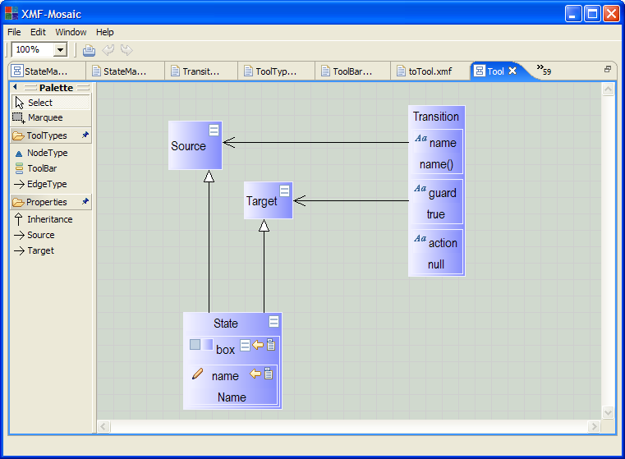
An XTool For State Machines

